Slide 1


SPECTRUM MARKETPLACE​
TOWARDS EFFICIENT AND EFFECTIVE USE OF RADIO FREQUENCIES

Slide 2



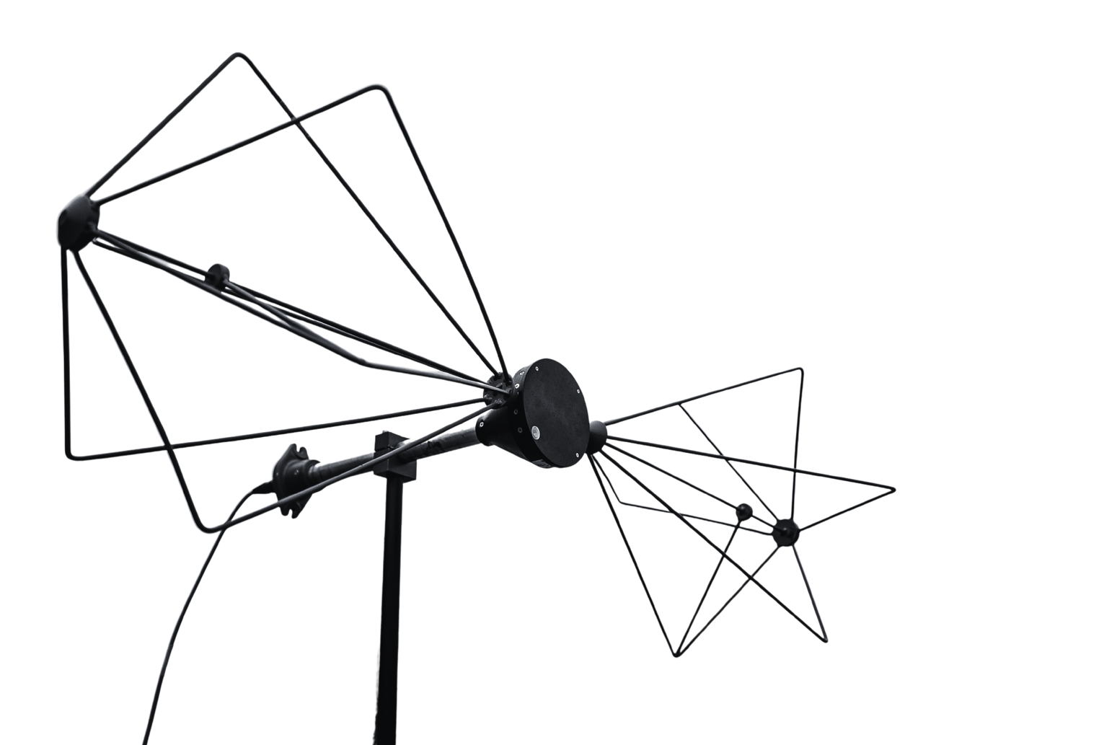
WHAT’S IN COMMON

Slide 3



CONTEXT: SCOPE
RRT aims to ensure efficient use of radio spectrum and avoid radio interference between different communication systems
radio frequency (RF) management
(as limited natural resource – state asset)​
RF are allocated in National Frequency Allocation Table (NFAT) for services and applications

Slide 4

CONTEXT:
FREQUENCY USAGE
without a separate RRT permit (from specific list of RF with associated usage conditions)
with RRT permit (usage conditions are set in NFAT and radio communication development plans)​
assigned upon receipt of an application​ (paper form)
fees charged (for services and work performed in issuing permit)

Slide 5



CONTEXT: PROBLEM
no effective and promptly way to determine whether RF is occupied/available/reserved​
the frequency holder does not use all his frequencies
application procedure is old-fashioned (paper form)

Slide 6

CHALLENGE
How to facilitate user access to frequency information and make management and allocation more efficient?

Slide 7



KEY FUNCTIONS
frequency information in online GIS platform
user interface for frequency application
network sharing concept for same type of communications

Slide 8
METRICS FOR﻿ SUCESS​
online system for finding out RF status and conditions of use at any point in the territory of Lithuania​
user friendly application management and effective frequency allocation process
sharing of occupied but unused frequencies
less administrative burden for RRT

Slide 9
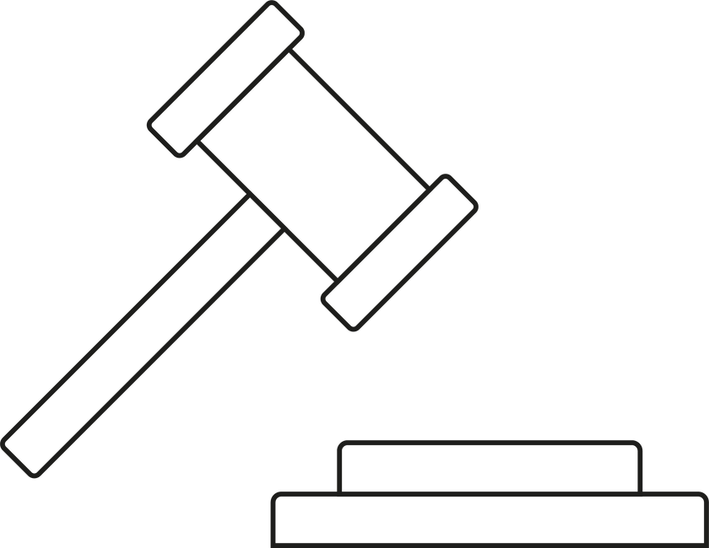
IMPORTANT
ASPECT​
network sharing is not specified in the legislations

Slide 10






BENEFICERIES
all groups
of society
business entities
frequency holders
RRT

Slide 11
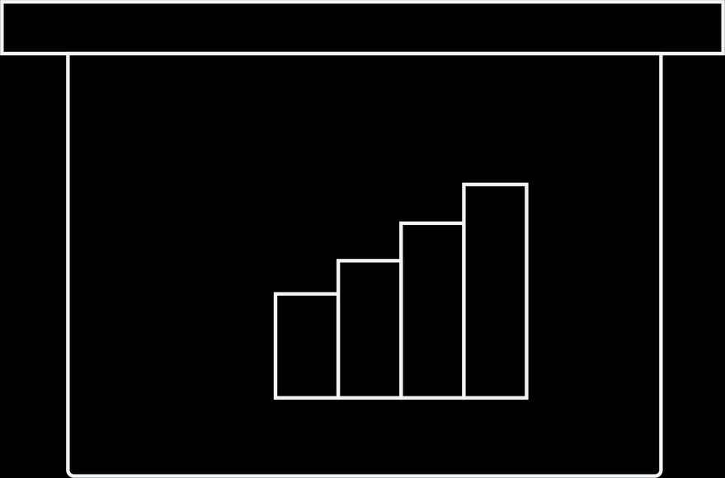

OPPORTUNITIES:
institution
opening the data for public – interactive and user-friendly​
improved spectrum management
digitalisation
similar challenges for other RRT fields of activity (e. g. regulations of postal and electronic communication sectors)

Slide 12

OPPORTUNITIES​:
MARKET
NATIONAL
INTERNATIONAL
emergence of
new services
each country in the world has their national regulators for radio spectrum management

Slide 13
CAN WE IMPROVE SPECTRUM MANAGEMENT TOGETHER?​

Slide 14
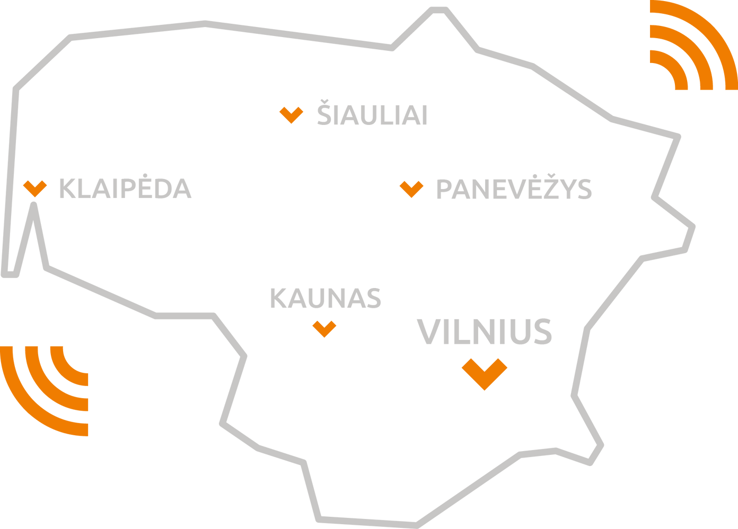


www.rrt.lt
Ryšių reguliavimo tarnyba
RRT | The Communications Regulatory Authority of the Republic of Lithuania

